Slide 1

The Strategy Pattern & SRP
Decoupling Algorithms for Maintainable, Extensible Architectures

Slide 2
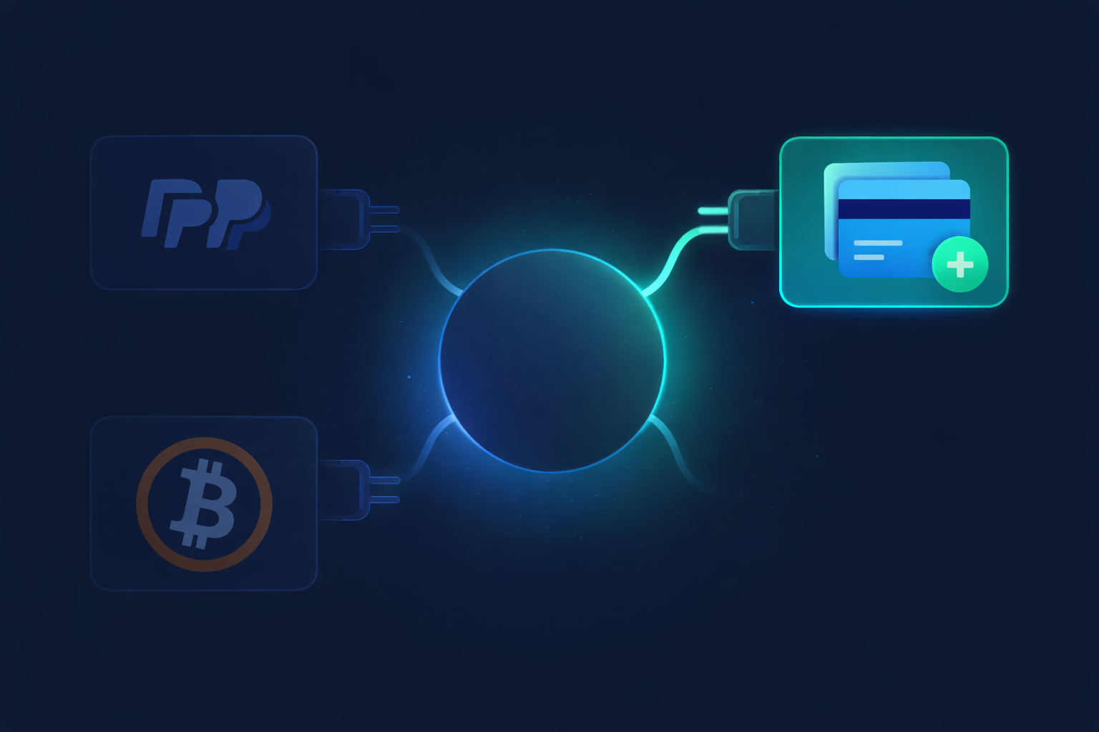
Defining the Strategy Pattern
Encapsulated Behaviors
The Strategy Pattern defines a family of algorithms, encapsulates each one, and makes them interchangeable at runtime.
Composition over Inheritance.
Dynamic behavior switching.
Strong Isolation of Logic.

Slide 3
PART I
The "God Class" Monolith
A Single Responsibility Principle (SRP) Violation

Slide 4


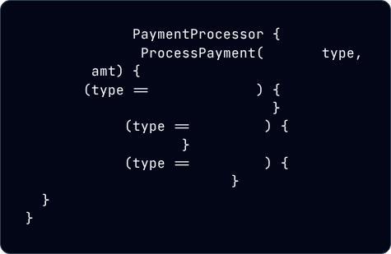
The Single-Method Monolith
C# Code Implementation
SRP Violations
public class
This class has many reasons to change, failing the fundamental rule of SRP:
public void
string
decimal
if
"CreditCard"
/* 50 lines of Visa/Master logic */
Change to PayPal API breaks the file.
else if
"PayPal"
/* API Handshake logic */
Adding "Apple Pay" requires editing core logic.
else if
"Crypto"
/* Blockchain validation */
Testing Crypto requires mocking PayPal.

Slide 5
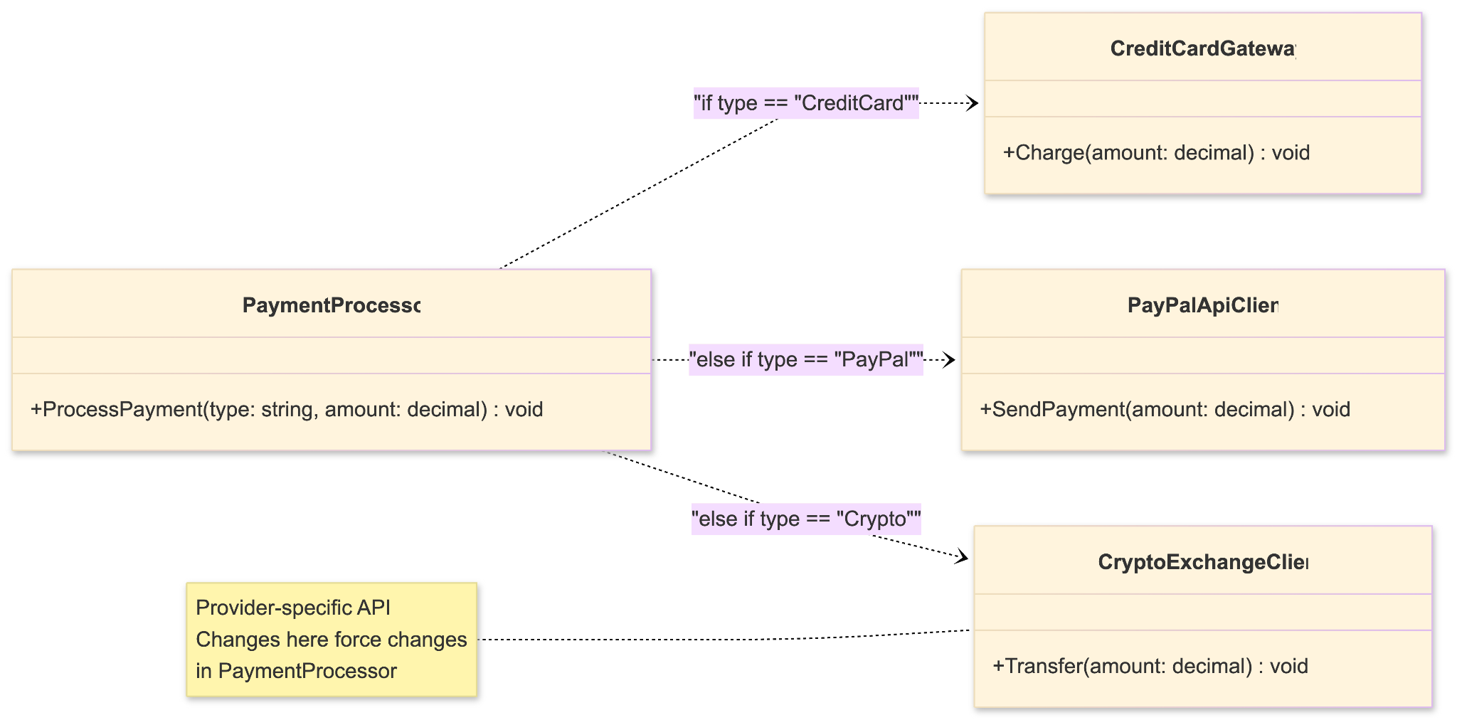
Fragile Complexity
The Cost of High Coupling
In a monolithic method, logic for unrelated features is tangled together. This "spaghetti code" creates a fragile system where a change in one area causes unexpected regressions in another.
The more payment methods you add, the more difficult the class becomes to read, maintain, and unit test effectively.

Slide 6
PART II
Refactoring to Strategy
Enforcing Single Responsibility through Interfaces

Slide 7
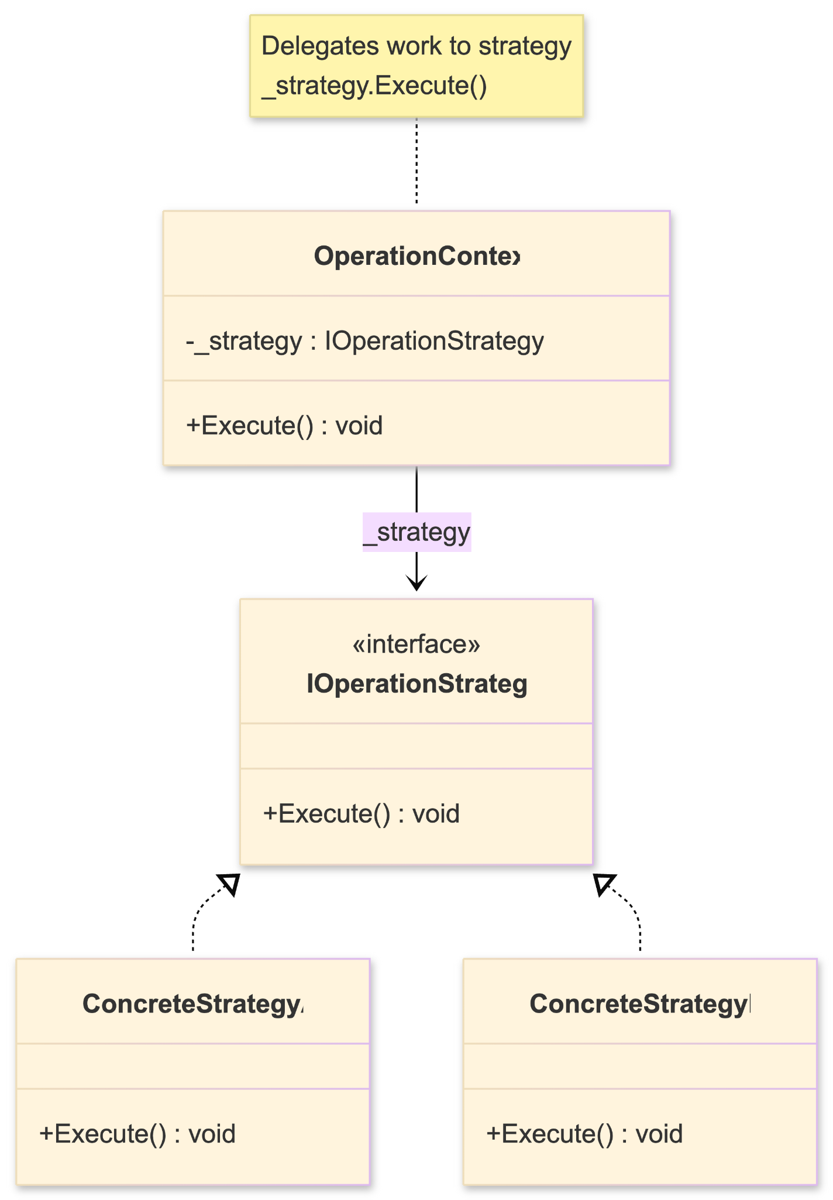
The Strategy UML Pattern
Anatomy of the Pattern
Context: Maintains a reference to the Strategy.
Strategy: The common interface (IPayment).
ConcreteStrategy: Individual classes implementing unique logic (e.g., PayPalStrategy).
The client interacts with the Context, oblivious to which ConcreteStrategy is actually executing.

Slide 8
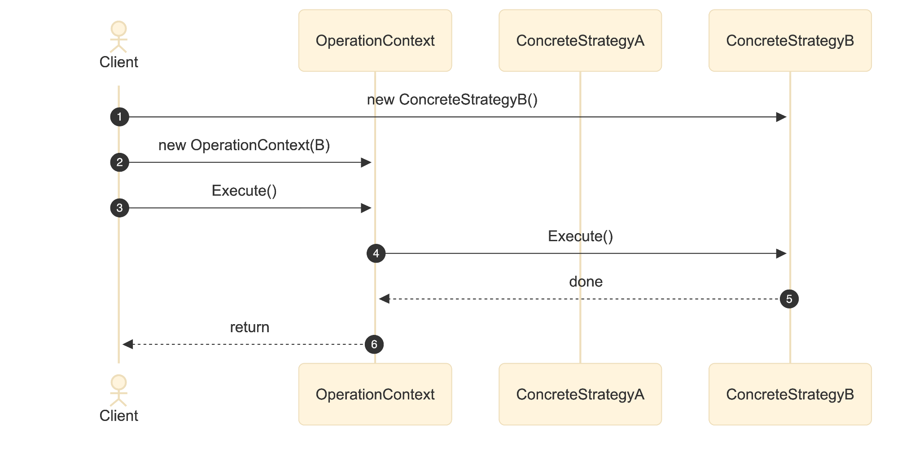
The Strategy UML Pattern
Sequence Diagram

Slide 9


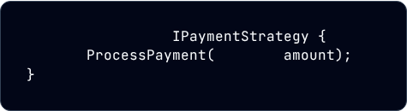
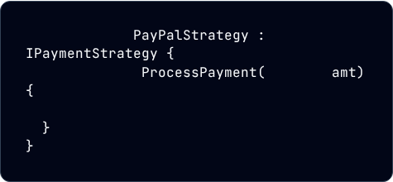
Defining the Contract
1. The Strategy Interface
2. Concrete Strategies
public interface
public class
void
decimal
public void
decimal
// PayPal API Handshake ONLY
A clean, single-method contract that all algorithms must follow.
Now, each class has exactly one reason to change.

Slide 10
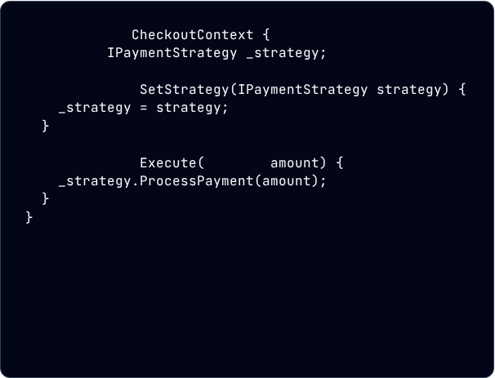
Context: The Runtime Switch
Decouples the Checkout flow from payment logic.
public class
private
public void
Algorithms are "plugged in" dynamically.
Easy to swap strategies mid-session.
public void
decimal

Slide 11



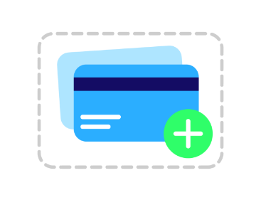
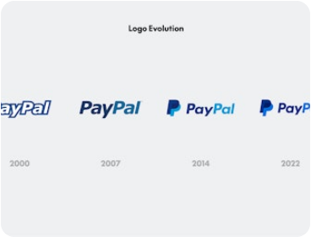

Modular Payment Models
Card Strategy
PayPal Strategy
Crypto Strategy
Validation, encryption, and banking gateway integration.
OAuth2 authentication and external redirect handshakes.
Blockchain verification and wallet address confirmation.

Slide 12
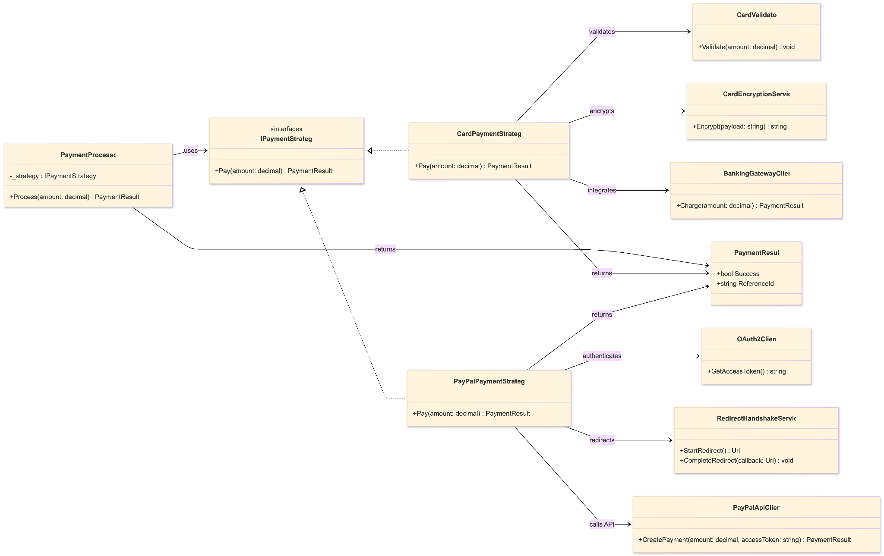
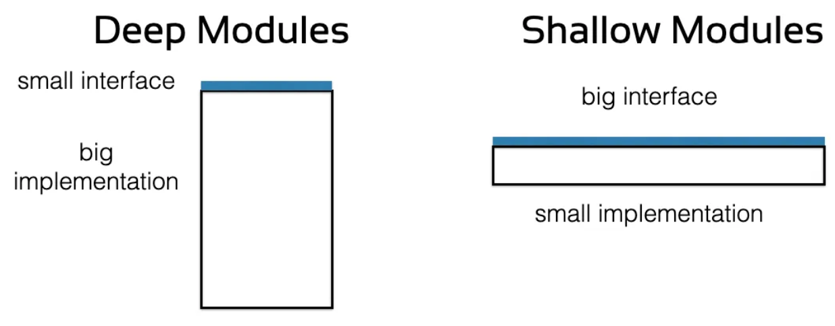
With Strategy
PaymentProcessor receives the payment strategy.
Coupling is limited to the dependencies of each payment strategy.
Each class has a single reason to change.
New processors can be added without changes to existing processors.
Modules Should Be Deep!
- Ousterhout

Slide 13
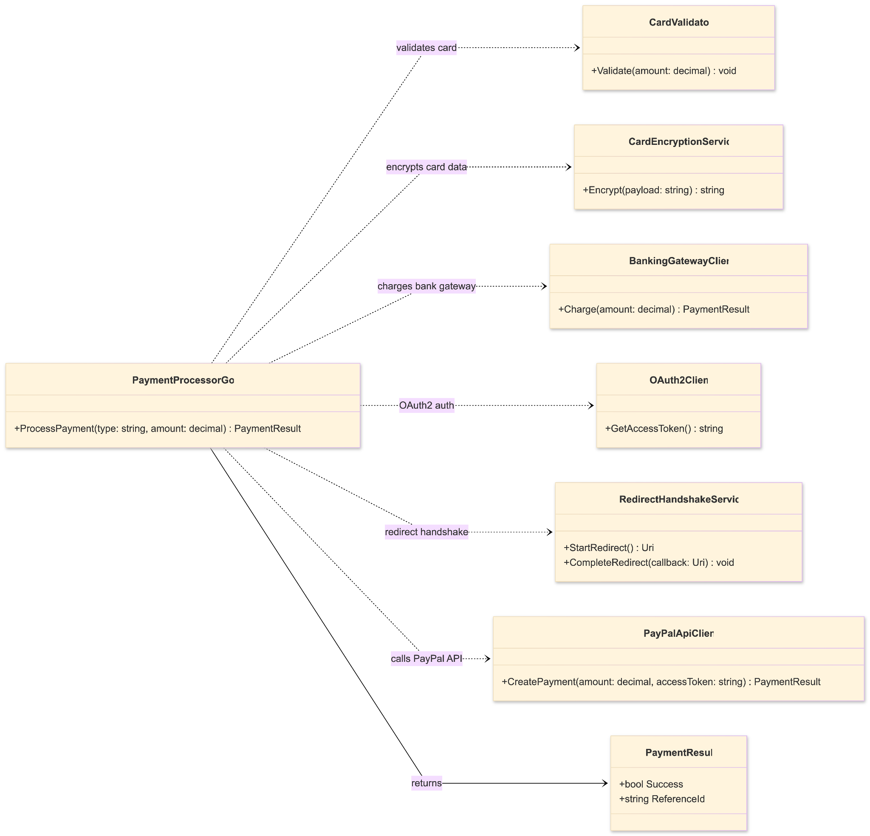
Without Strategy
All payment models live in PaymentProcessor
High coupling: dependencies created on every provider + helper (today and all future)
Many reasons to change:
- new payment type
- API change (PayPal/gateway/crypto)
- validation/encryption rules
Hard to test: must mock unrelated systems

Slide 14
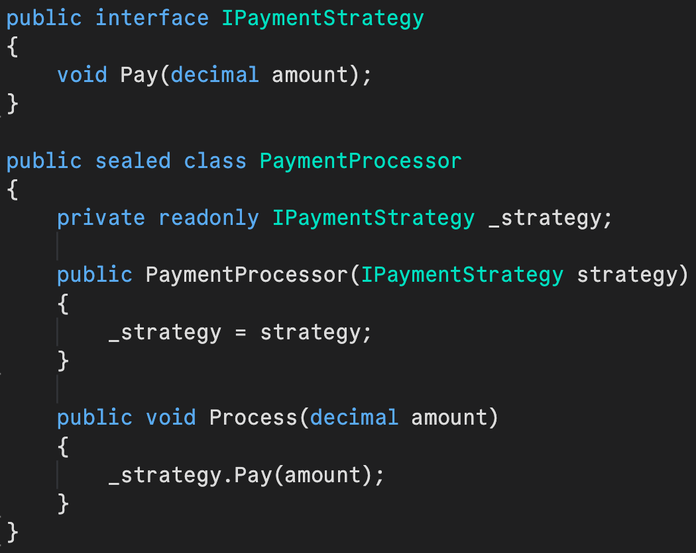
C# Demo
Notes:
public static class Program
{
public static void Main()
{
Console.WriteLine("Choose payment method:");
Console.WriteLine("1 - Card");
Console.WriteLine("2 - PayPal");
var choice = Console.ReadLine();
IPaymentStrategy strategy = choice switch
{±
"1" => new CardPaymentStrategy("**** **** **** 1234", 10, 2026),
"2" => new PayPalPaymentStrategy("user@example.com"),
_ => throw new InvalidOperationException("Invalid payment choice")
};
var processor = new PaymentProcessor(strategy);
processor.Process(49.99m);
}
}
public interface IPaymentStrategy
{
void Pay(decimal amount);
}
public sealed class PaymentProcessor
{
private readonly IPaymentStrategy _strategy;
public PaymentProcessor(IPaymentStrategy strategy)
{
_strategy = strategy;
}
public void Process(decimal amount)
{
_strategy.Pay(amount);
}
}
// ---- Concrete strategies ----
public sealed class CardPaymentStrategy : IPaymentStrategy
{
private readonly string _maskedCardNumber;
private readonly int _monthEx;
private readonly int _yearEx;
public CardPaymentStrategy(string maskedCardNumber, int monthEx, int yearEx)
{
_maskedCardNumber = maskedCardNumber;
_monthEx = monthEx;
_yearEx = yearEx;
}
public void Pay(decimal amount)
{
Console.WriteLine(
$"Charging {amount:C} to card {_maskedCardNumber} " +
$"exp { _monthEx}/{ _yearEx}"
);
}
}
public sealed class PayPalPaymentStrategy : IPaymentStrategy
{
private readonly string _emailAddress;
public PayPalPaymentStrategy(string emailAddress)
{
_emailAddress = emailAddress;
}
public void Pay(decimal amount)
{
Console.WriteLine(
$"Paying {amount:C} via PayPal account {_emailAddress}."
);
}
}

Slide 15
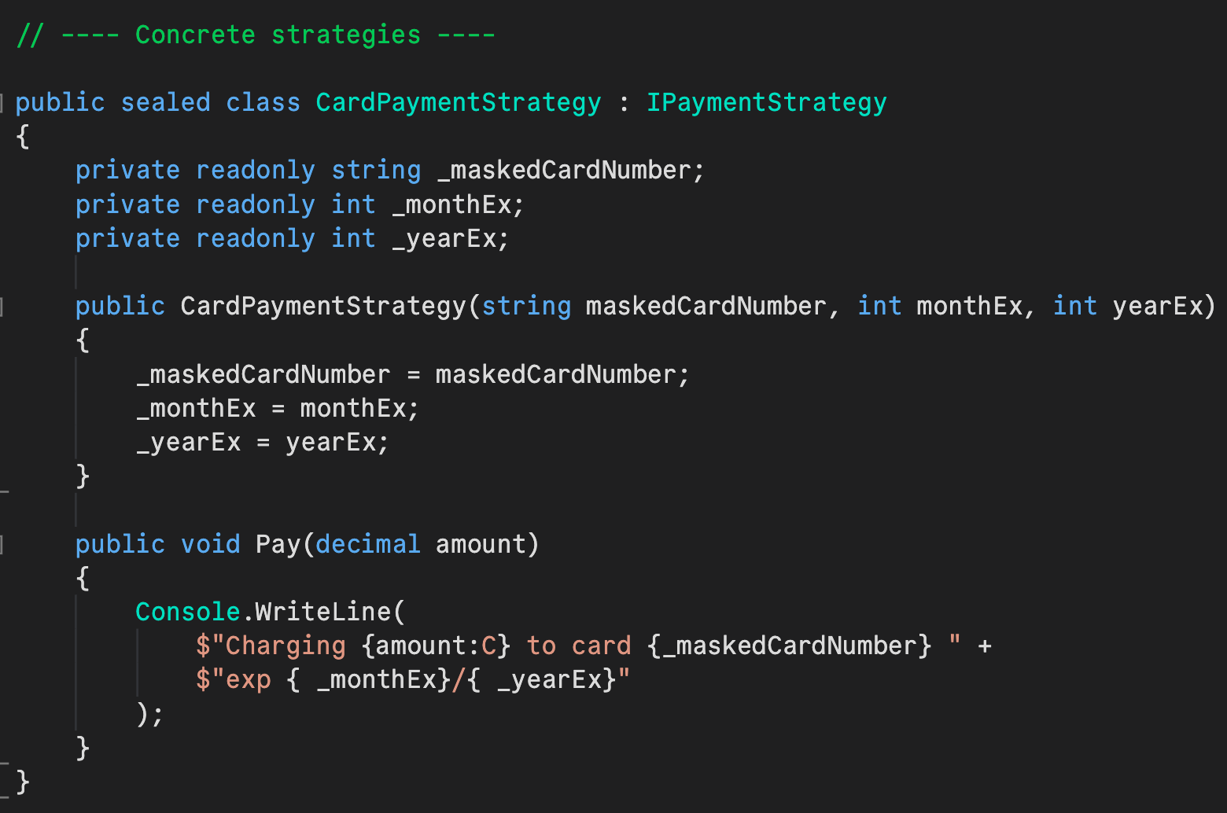
C# Demo
Notes:
public static class Program
{
public static void Main()
{
Console.WriteLine("Choose payment method:");
Console.WriteLine("1 - Card");
Console.WriteLine("2 - PayPal");
var choice = Console.ReadLine();
IPaymentStrategy strategy = choice switch
{±
"1" => new CardPaymentStrategy("**** **** **** 1234", 10, 2026),
"2" => new PayPalPaymentStrategy("user@example.com"),
_ => throw new InvalidOperationException("Invalid payment choice")
};
var processor = new PaymentProcessor(strategy);
processor.Process(49.99m);
}
}
public interface IPaymentStrategy
{
void Pay(decimal amount);
}
public sealed class PaymentProcessor
{
private readonly IPaymentStrategy _strategy;
public PaymentProcessor(IPaymentStrategy strategy)
{
_strategy = strategy;
}
public void Process(decimal amount)
{
_strategy.Pay(amount);
}
}
// ---- Concrete strategies ----
public sealed class CardPaymentStrategy : IPaymentStrategy
{
private readonly string _maskedCardNumber;
private readonly int _monthEx;
private readonly int _yearEx;
public CardPaymentStrategy(string maskedCardNumber, int monthEx, int yearEx)
{
_maskedCardNumber = maskedCardNumber;
_monthEx = monthEx;
_yearEx = yearEx;
}
public void Pay(decimal amount)
{
Console.WriteLine(
$"Charging {amount:C} to card {_maskedCardNumber} " +
$"exp { _monthEx}/{ _yearEx}"
);
}
}
public sealed class PayPalPaymentStrategy : IPaymentStrategy
{
private readonly string _emailAddress;
public PayPalPaymentStrategy(string emailAddress)
{
_emailAddress = emailAddress;
}
public void Pay(decimal amount)
{
Console.WriteLine(
$"Paying {amount:C} via PayPal account {_emailAddress}."
);
}
}

Slide 16
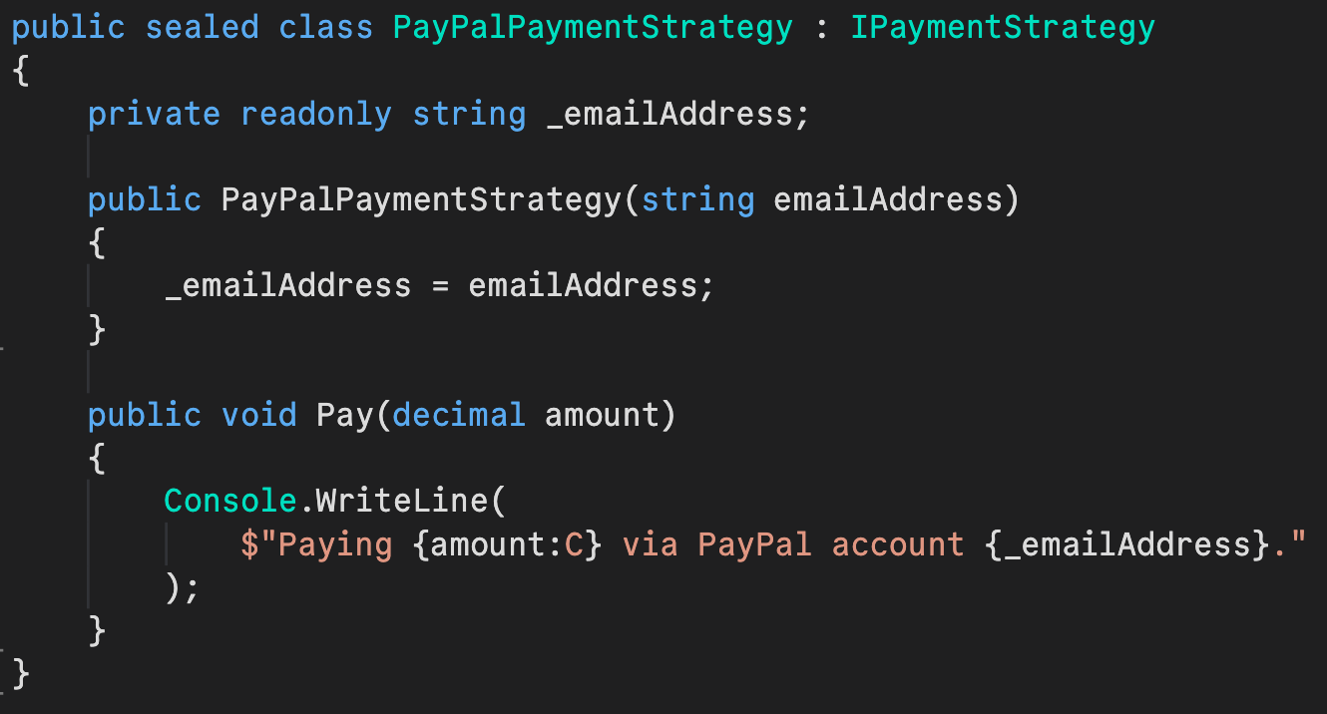
C# Demo
Notes:
public static class Program
{
public static void Main()
{
Console.WriteLine("Choose payment method:");
Console.WriteLine("1 - Card");
Console.WriteLine("2 - PayPal");
var choice = Console.ReadLine();
IPaymentStrategy strategy = choice switch
{±
"1" => new CardPaymentStrategy("**** **** **** 1234", 10, 2026),
"2" => new PayPalPaymentStrategy("user@example.com"),
_ => throw new InvalidOperationException("Invalid payment choice")
};
var processor = new PaymentProcessor(strategy);
processor.Process(49.99m);
}
}
public interface IPaymentStrategy
{
void Pay(decimal amount);
}
public sealed class PaymentProcessor
{
private readonly IPaymentStrategy _strategy;
public PaymentProcessor(IPaymentStrategy strategy)
{
_strategy = strategy;
}
public void Process(decimal amount)
{
_strategy.Pay(amount);
}
}
// ---- Concrete strategies ----
public sealed class CardPaymentStrategy : IPaymentStrategy
{
private readonly string _maskedCardNumber;
private readonly int _monthEx;
private readonly int _yearEx;
public CardPaymentStrategy(string maskedCardNumber, int monthEx, int yearEx)
{
_maskedCardNumber = maskedCardNumber;
_monthEx = monthEx;
_yearEx = yearEx;
}
public void Pay(decimal amount)
{
Console.WriteLine(
$"Charging {amount:C} to card {_maskedCardNumber} " +
$"exp { _monthEx}/{ _yearEx}"
);
}
}
public sealed class PayPalPaymentStrategy : IPaymentStrategy
{
private readonly string _emailAddress;
public PayPalPaymentStrategy(string emailAddress)
{
_emailAddress = emailAddress;
}
public void Pay(decimal amount)
{
Console.WriteLine(
$"Paying {amount:C} via PayPal account {_emailAddress}."
);
}
}

Slide 17
C# Demo
Notes:
public static class Program
{
public static void Main()
{
Console.WriteLine("Choose payment method:");
Console.WriteLine("1 - Card");
Console.WriteLine("2 - PayPal");
var choice = Console.ReadLine();
IPaymentStrategy strategy = choice switch
{±
"1" => new CardPaymentStrategy("**** **** **** 1234", 10, 2026),
"2" => new PayPalPaymentStrategy("user@example.com"),
_ => throw new InvalidOperationException("Invalid payment choice")
};
var processor = new PaymentProcessor(strategy);
processor.Process(49.99m);
}
}
public interface IPaymentStrategy
{
void Pay(decimal amount);
}
public sealed class PaymentProcessor
{
private readonly IPaymentStrategy _strategy;
public PaymentProcessor(IPaymentStrategy strategy)
{
_strategy = strategy;
}
public void Process(decimal amount)
{
_strategy.Pay(amount);
}
}
// ---- Concrete strategies ----
public sealed class CardPaymentStrategy : IPaymentStrategy
{
private readonly string _maskedCardNumber;
private readonly int _monthEx;
private readonly int _yearEx;
public CardPaymentStrategy(string maskedCardNumber, int monthEx, int yearEx)
{
_maskedCardNumber = maskedCardNumber;
_monthEx = monthEx;
_yearEx = yearEx;
}
public void Pay(decimal amount)
{
Console.WriteLine(
$"Charging {amount:C} to card {_maskedCardNumber} " +
$"exp { _monthEx}/{ _yearEx}"
);
}
}
public sealed class PayPalPaymentStrategy : IPaymentStrategy
{
private readonly string _emailAddress;
public PayPalPaymentStrategy(string emailAddress)
{
_emailAddress = emailAddress;
}
public void Pay(decimal amount)
{
Console.WriteLine(
$"Paying {amount:C} via PayPal account {_emailAddress}."
);
}
}

Slide 18
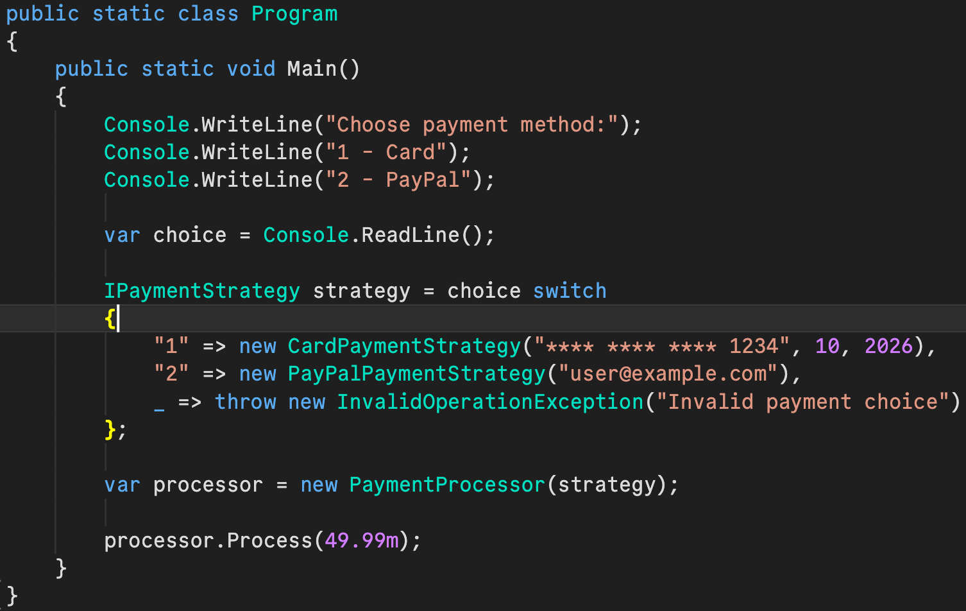
C# Demo
Notes:
public static class Program
{
public static void Main()
{
Console.WriteLine("Choose payment method:");
Console.WriteLine("1 - Card");
Console.WriteLine("2 - PayPal");
var choice = Console.ReadLine();
IPaymentStrategy strategy = choice switch
{±
"1" => new CardPaymentStrategy("**** **** **** 1234", 10, 2026),
"2" => new PayPalPaymentStrategy("user@example.com"),
_ => throw new InvalidOperationException("Invalid payment choice")
};
var processor = new PaymentProcessor(strategy);
processor.Process(49.99m);
}
}
public interface IPaymentStrategy
{
void Pay(decimal amount);
}
public sealed class PaymentProcessor
{
private readonly IPaymentStrategy _strategy;
public PaymentProcessor(IPaymentStrategy strategy)
{
_strategy = strategy;
}
public void Process(decimal amount)
{
_strategy.Pay(amount);
}
}
// ---- Concrete strategies ----
public sealed class CardPaymentStrategy : IPaymentStrategy
{
private readonly string _maskedCardNumber;
private readonly int _monthEx;
private readonly int _yearEx;
public CardPaymentStrategy(string maskedCardNumber, int monthEx, int yearEx)
{
_maskedCardNumber = maskedCardNumber;
_monthEx = monthEx;
_yearEx = yearEx;
}
public void Pay(decimal amount)
{
Console.WriteLine(
$"Charging {amount:C} to card {_maskedCardNumber} " +
$"exp { _monthEx}/{ _yearEx}"
);
}
}
public sealed class PayPalPaymentStrategy : IPaymentStrategy
{
private readonly string _emailAddress;
public PayPalPaymentStrategy(string emailAddress)
{
_emailAddress = emailAddress;
}
public void Pay(decimal amount)
{
Console.WriteLine(
$"Paying {amount:C} via PayPal account {_emailAddress}."
);
}
}

Slide 19
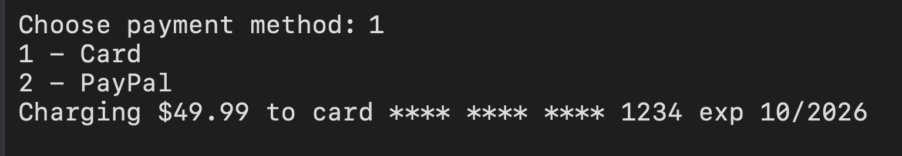
C# Demo
Notes:
public static class Program
{
public static void Main()
{
Console.WriteLine("Choose payment method:");
Console.WriteLine("1 - Card");
Console.WriteLine("2 - PayPal");
var choice = Console.ReadLine();
IPaymentStrategy strategy = choice switch
{±
"1" => new CardPaymentStrategy("**** **** **** 1234", 10, 2026),
"2" => new PayPalPaymentStrategy("user@example.com"),
_ => throw new InvalidOperationException("Invalid payment choice")
};
var processor = new PaymentProcessor(strategy);
processor.Process(49.99m);
}
}
public interface IPaymentStrategy
{
void Pay(decimal amount);
}
public sealed class PaymentProcessor
{
private readonly IPaymentStrategy _strategy;
public PaymentProcessor(IPaymentStrategy strategy)
{
_strategy = strategy;
}
public void Process(decimal amount)
{
_strategy.Pay(amount);
}
}
// ---- Concrete strategies ----
public sealed class CardPaymentStrategy : IPaymentStrategy
{
private readonly string _maskedCardNumber;
private readonly int _monthEx;
private readonly int _yearEx;
public CardPaymentStrategy(string maskedCardNumber, int monthEx, int yearEx)
{
_maskedCardNumber = maskedCardNumber;
_monthEx = monthEx;
_yearEx = yearEx;
}
public void Pay(decimal amount)
{
Console.WriteLine(
$"Charging {amount:C} to card {_maskedCardNumber} " +
$"exp { _monthEx}/{ _yearEx}"
);
}
}
public sealed class PayPalPaymentStrategy : IPaymentStrategy
{
private readonly string _emailAddress;
public PayPalPaymentStrategy(string emailAddress)
{
_emailAddress = emailAddress;
}
public void Pay(decimal amount)
{
Console.WriteLine(
$"Paying {amount:C} via PayPal account {_emailAddress}."
);
}
}

Slide 20
Architecture Comparison
Criteria | God Class (Monolith) | Strategy Pattern
SRP Compliance | None (Many reasons to change) | Full (One reason to change per class)
Testability | Hard (Must mock every payment type) | Easy (Test algorithms in isolation)
Extensibility | Hard (Modify existing method) | Easy (Add new strategy class)
Runtime Switching | Manual logic branches | Native polymorphism

